Slide 1

Practice 4: Perceptron
Machine learning
Group Ten

Slide 2
01
Division of tasks
02
Process & Code
CONTENTS
03
Results & Comparison
04
Problems & further plan

Slide 3
01
Division of tasks
Group ten
Code :
Perceptron Algorithm: Tian Le
Logistic Regression: Wei Shanming
Multi-class perceptron Algorithm: Gu Zhengzhao
Softmax Regression: Ying Zijian
Powerpoint: Hou Xiaoyu
Presentation: Hou Xiaoyu

Slide 4
02
Process & Code
Group ten
Perceptron Algorithm
Logistic Regression
Multi-class perceptron Algorithm
Softmax Regression

Slide 5
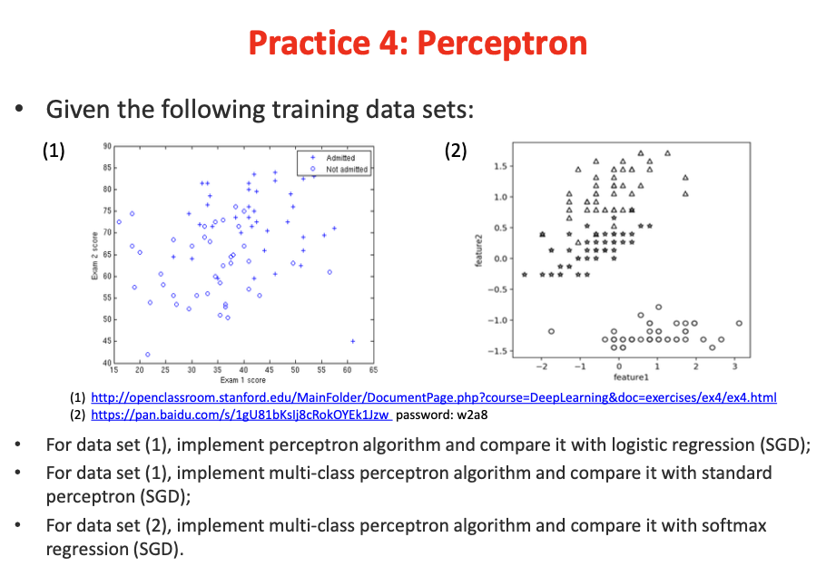
Process
problem
Handle training data
Normalize the data
Plot distribution
2. Calculate cost function and updating weight
3. Get results and compare different

Slide 6

perceptron
Perceptron cost function
$$J_{P}\left(x\right)=\sum_{i=1}^{N}{(h_{w}\left(x^{\left(i\right)}\right)−y^{(i)})}w^{T}x^{(i)}$$
Perceptron updating rule(by applying SGD)
$$w=\left\{\begin{aligned}w+ax, if y=1 and h_{w}\left(x\right)=0 \\ w−ax, if y=0 and h_{w}\left(x\right)=1 \\ w, otherwise\end{aligned}\right.$$

Slide 7

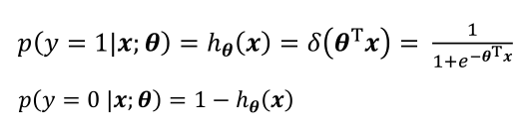

Logistic Regression
Logistic Regression cost function
Logistic Regression updating rule(by applying SGD)
$$w=θ ≔ θ +a\left(y − h_{θ}\left(x\right)\right) x$$

Slide 8
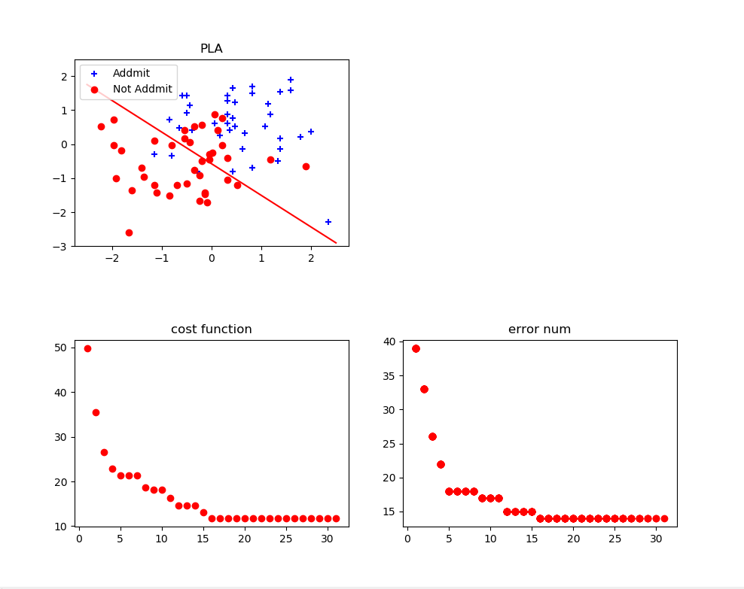
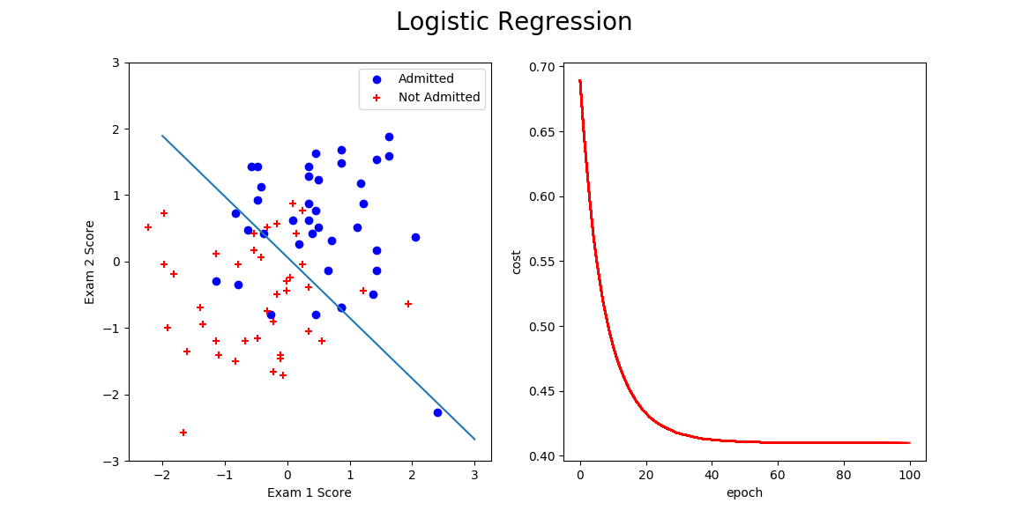
results for problem1
Standard perceptron Logistic Regression

Slide 9
Comparison
Outputs(true label) are different. (perceptron is 1 or 0, the other is from 0 to 1.
Perceptron can only solve linear separable data. It is not suitable for non-separable data.
Logstic regression needs more time than perceptron. Because firstly, active function of logstic regression is more complex than perceptron (exp). Secondly, it is easier for perceptron updating rules to calculate which is need one data. Logstic regression needs to calculate all data.

Slide 10
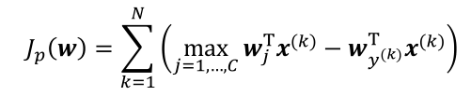
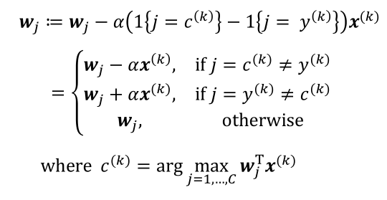
Multi-class Perceptron
Multi-class Perceptron cost function
Multi-class Perceptron updating rule(by applying SGD)

Slide 11
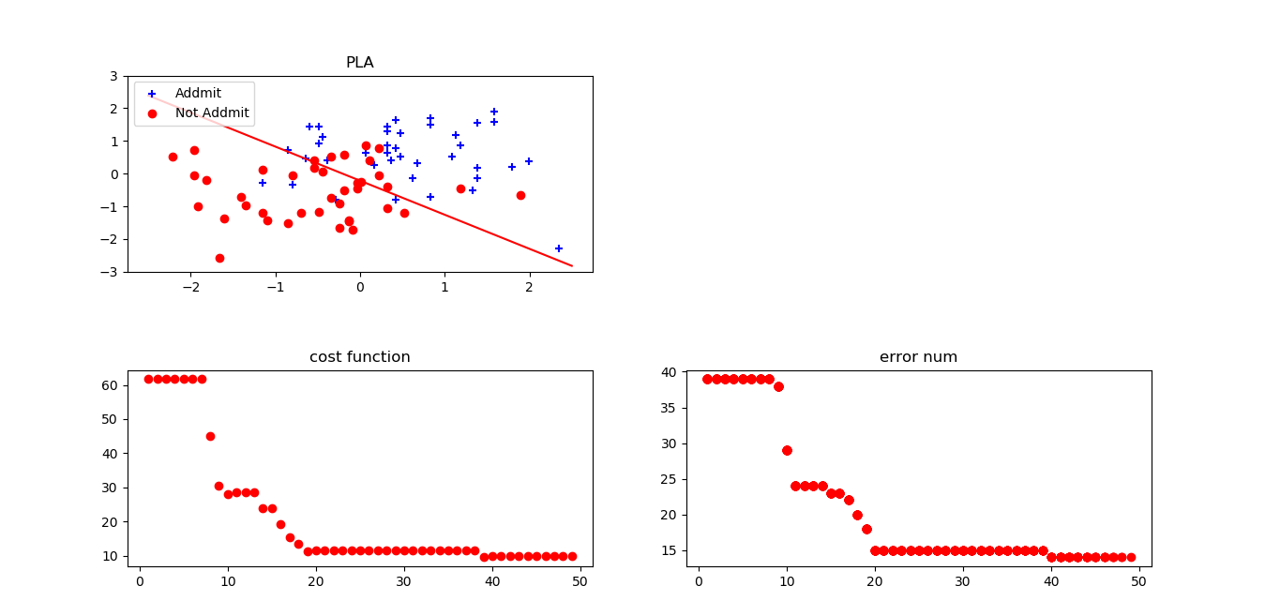
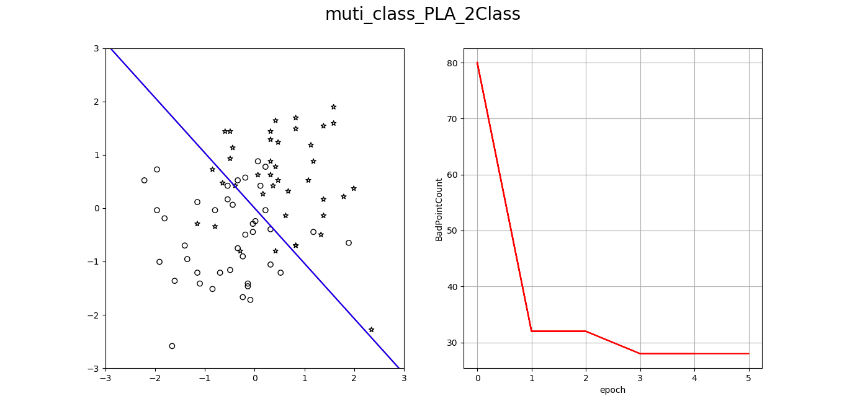
results for problem2
Standard perceptron multi-class perceptron

Slide 12
Comparison
Multi_class perceptron can be regarded as an extension of standard perceptron.(one to one&one to rest)
PLA algorithm has many limitations, it can only deal with linearly separable data, and can only be used for binary classification. Although pocket_PLA algorithm can solve the problem of linear unseparable problem, the number of iterations is difficult to set reasonably

Slide 13



Softmax Regression
Softmax Regression cost function
Softmax Regression updating rule(by applying SGD)
$$w=θ_{j} ≔θ_{j}+a\left(1\{y=j\} − h_{j}\left(x\right)\right) x$$

Slide 14
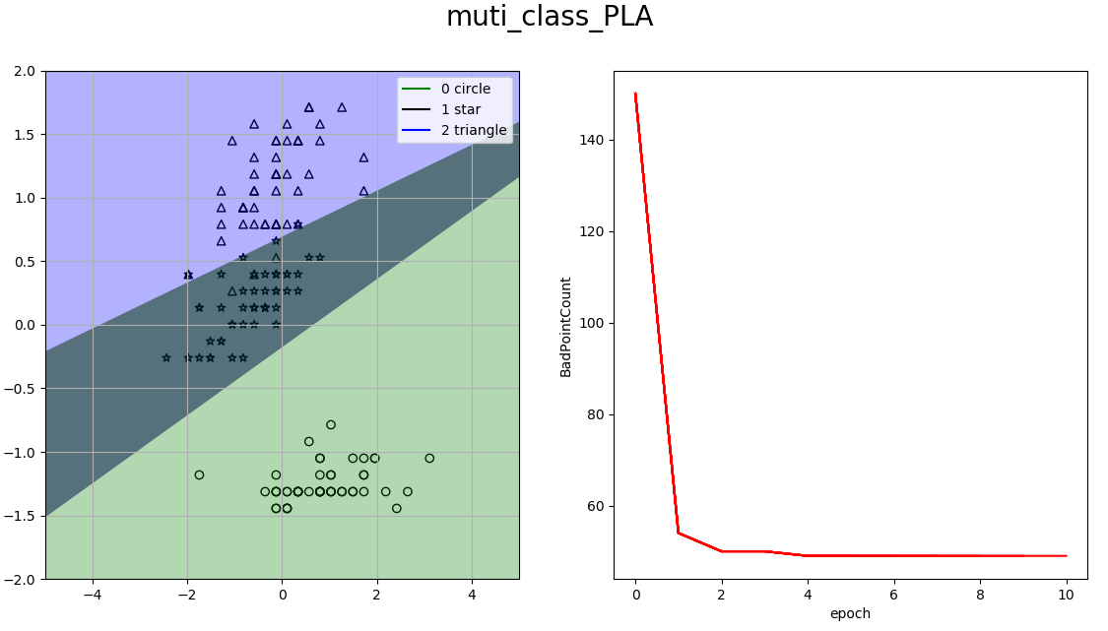
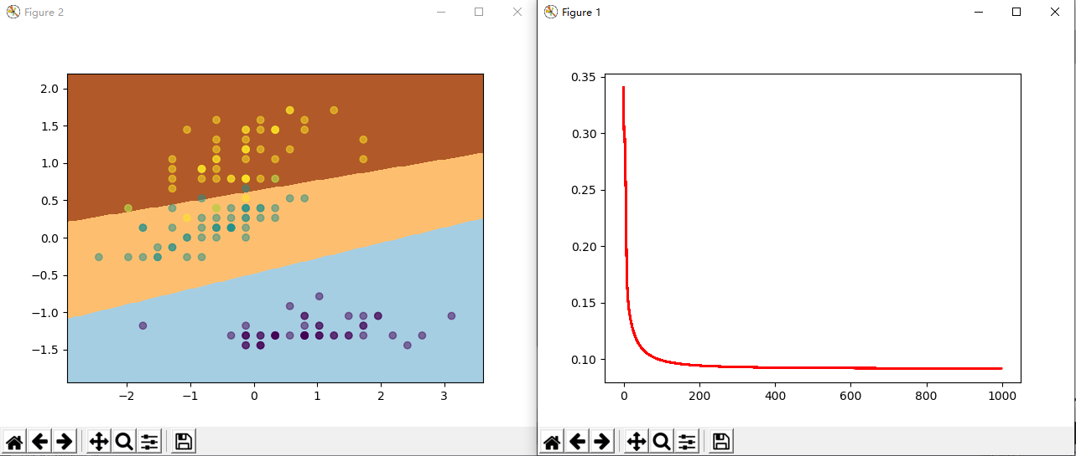
results for problem3
Multi-class perceptron Softmax Regression

Slide 15
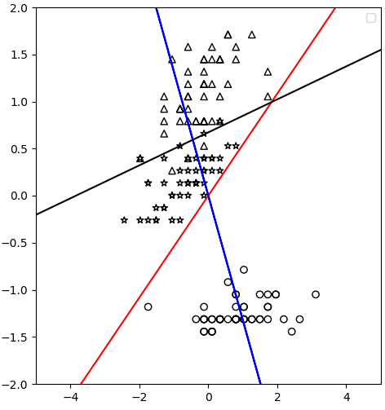

Comparison
Softmax regression needs more computing time than multi-class perceptron. Because compared with multi-class perceptron, the updating rule of softmax regression is more complicated.($w_{c}^{k}$and $w_{y}^{k}$)
Multi-class perceptron can also be used into simple multi-class perceptron. However, multi-class PLA is a linear Algorithm after all, so it can not process complex classification.(eg: the date shaped as star)

Slide 16
Thanks for listening

Slide 17

Q & A
https://github.com/dadaxian/machinelearning_perceptron

